Slide 1
Software Cost Estimation
Main issues:
What factors determine cost/effort?
How to relate effort to development time?
©2008 John Wiley & Sons Ltd.
www.wileyeurope.com/college/van vliet
Notes:
© SE, Cost estimation, Hans van Vliet

Slide 2

Cost estimation, topics
Quantitative models (E = 2.5 KLOC^{1.05})
Qualitative models (e.g. expert estimation)
Agile cost estimation
Relate cost to development time
©2008 John Wiley & Sons Ltd.
www.wileyeurope.com/college/van vliet

Slide 3

On productivity
Even if quantitative models are not that good, the cost drivers of these models learn us about productivity:
  Writing less code helps
  Reuse helps
  Quality of people is important
  Tools help
  …
©2008 John Wiley & Sons Ltd.
www.wileyeurope.com/college/van vliet

Slide 4
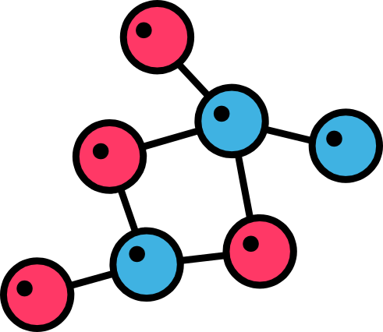
Algorithmic models
Base formula: E = a + bKLOC^{c}
C usually is around 1
C > 1: diseconomy of scale
C < 1: economy of scale
This nominal cost is multiplied by a number of cost drivers (volatility of requirements, amount of documentation required, CMM level, quality of people, …)
©2008 John Wiley & Sons Ltd.
www.wileyeurope.com/college/van vliet

Slide 5
Walston-Felix
One of the early algorithmic models (1977)
Many factors (29 out of 51 projects)
Only three alternatives (high, medium, low) per factor
Its form influenced many later models
©2008 John Wiley & Sons Ltd.
www.wileyeurope.com/college/van vliet

Slide 6
COCOMO (COnstructive COst MOdel)
Very well-documented (Boehm book, 1981)
Basic form: E = bKLOC^{c}, where b (~3) and c (1+ε) depend on the type of project (mode):
  Organic: relatively small and well-known
  Embedded: inflexible environment with many constraints
  Semidetached: somewhere in between
More complex form: takes into account 15 multiplicative cost drivers
©2008 John Wiley & Sons Ltd.
www.wileyeurope.com/college/van vliet

Slide 7
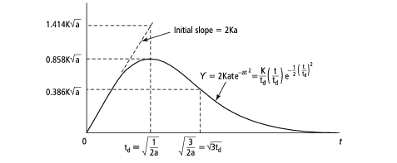
Putnam model, Rayleigh curve
©2008 John Wiley & Sons Ltd.
www.wileyeurope.com/college/van vliet

Slide 8
Function Point Analysis (FPA)
Size (=cost) is based on number of data structures used:
  I: number of input types
  O: number of output types
  E: number of enquiry types
  L: number of logical internal types
  F: number of interfaces
Then, magically, UFP = 4I + 5O + 10E + 4L + 7F
©2008 John Wiley & Sons Ltd.
www.wileyeurope.com/college/van vliet

Slide 9
FPA cnt’d
Somewhat more complex model: constants depend on complexity level (simple, average, complex)
Cost drivers (application characteristics) next adjust the value of UFP by at most +/- 40%
Extensive guidelines for counting Function Points
Reflects data-centric world of the 1970’s
Widely used
©2008 John Wiley & Sons Ltd.
www.wileyeurope.com/college/van vliet

Slide 10
COCOMO2
Successor to COCOMO
Three, increasingly complex models:
  Application composition model; counting components of large granularity, using object points (objects are: screens, reports, and the like); FPA-like, with 3 levels of complexity for each object.
  Early design model: same, but uses 7 cost drivers (project characteristics, combinations of cost drivers from the post-architecture version) instead of 3 simple complexity levels
  Post-architecture model: like COCOMO, with updated set of 17 cost drivers
Rather than having 3 modes (COCOMO), COCOMO2 has a more elaborate scaling model
©2008 John Wiley & Sons Ltd.
www.wileyeurope.com/college/van vliet

Slide 11
Use Case Points
FPA-like model, starting from use cases
Counting depends on the use case
  How many steps in success scenario
  How many classes in the implementation
  Complexity of the actors involved
Next, corrections for the technical and environmental complexity
©2008 John Wiley & Sons Ltd.
www.wileyeurope.com/college/van vliet

Slide 12

Difficulties with applying these models
People do not collect numbers, so:
  This project costs the same as the last project
  We have 6 months, so it will take 6 months
  …and other political estimates
These models require calibration
©2008 John Wiley & Sons Ltd.
www.wileyeurope.com/college/van vliet

Slide 13

Guidelines
Estimation ≠ planning ≠ bidding
Combine methods
Ask justification
Select experts with similar experience
Accept and assess uncertainty
Provide earning opportunities
Try to avoid, or postpone, effort estimation
©2008 John Wiley & Sons Ltd.
www.wileyeurope.com/college/van vliet

Slide 14
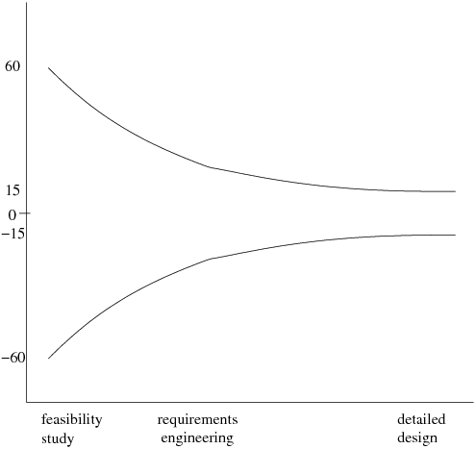
Cone of uncertainty
©2008 John Wiley & Sons Ltd.
www.wileyeurope.com/college/van vliet

Slide 15
From total effort to ⇒ number of months
A lot of consensus between models: T ≅ 2.5E^{1/3}
Compressing this value has a price:
  Team larger ⇒ more communication
  New people first slows down productivity
Combined: Brooks’ law:
Adding manpower to a late project makes it later
©2008 John Wiley & Sons Ltd.
www.wileyeurope.com/college/van vliet

Slide 16
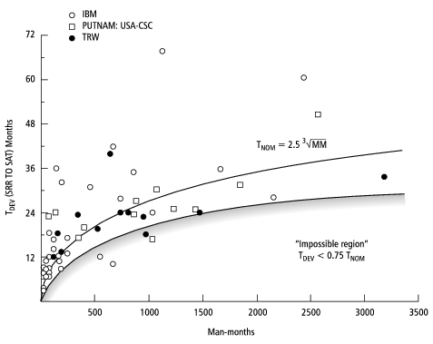
Impossible region
©2008 John Wiley & Sons Ltd.
www.wileyeurope.com/college/van vliet

Slide 17

Agile cost estimation
Estimate size of features in story points
These are relative sizes: one feature is twice as large as another one, etc.
Use a few simple relative sizes, e.g., 1, 2, 4, and 8
Use a Delphi-like procedure to get consensus
©2008 John Wiley & Sons Ltd.
www.wileyeurope.com/college/van vliet

Slide 18

Agile cost estimation, cnt’d
Translation of story points to real time: velocity: number of function points completed in one iteration
Start: yesterday’s weather: productivity is the same as that for the last project
If the outcome is wrong: adjust the velocity, not the story points
©2008 John Wiley & Sons Ltd.
www.wileyeurope.com/college/van vliet

